Slide 1
Distributed transaction using Saga pattern
</
} /> [
/>
Speaker: Trung Tran

Slide 2
</ Table of contents
{01}
{05}
Context & problems
Saga - Orchestrator
{02}
{06}
Saga - The solution
Issues & considerations
{03}
{07}
Techniques in Saga
Practical usage
{04}
{08}
Saga - Choreography
Discussion & QnA

Slide 3
</ Prerequisites
Must have
Basic knowledge in software architecture
Understanding of remote communication between servers/software components
Understanding of concurrency concepts
Nice to have
C#, .NET knowledge
Understanding of async communication
Experience of Docker
/>

Slide 4
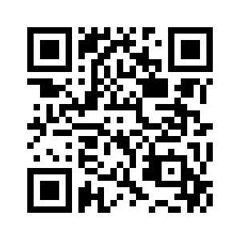
</ Resources
Repository URL:
https://github.com/trannamtrung1st/SagaSeminar
Requirements:
.NET SDK 6.0
Docker Desktop
/>

Slide 5
</ Saigon Technology
+300 software engineers
+10 years in business
3 development centers (2 offices in Singapore and USA)
Website: https://saigontechnology.com/
} /> [
/>

Slide 6
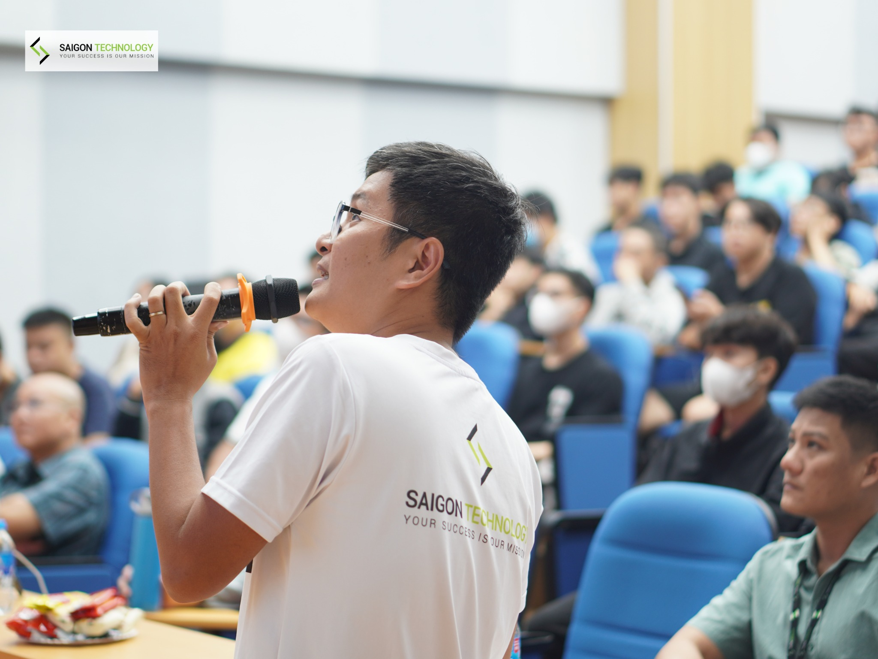
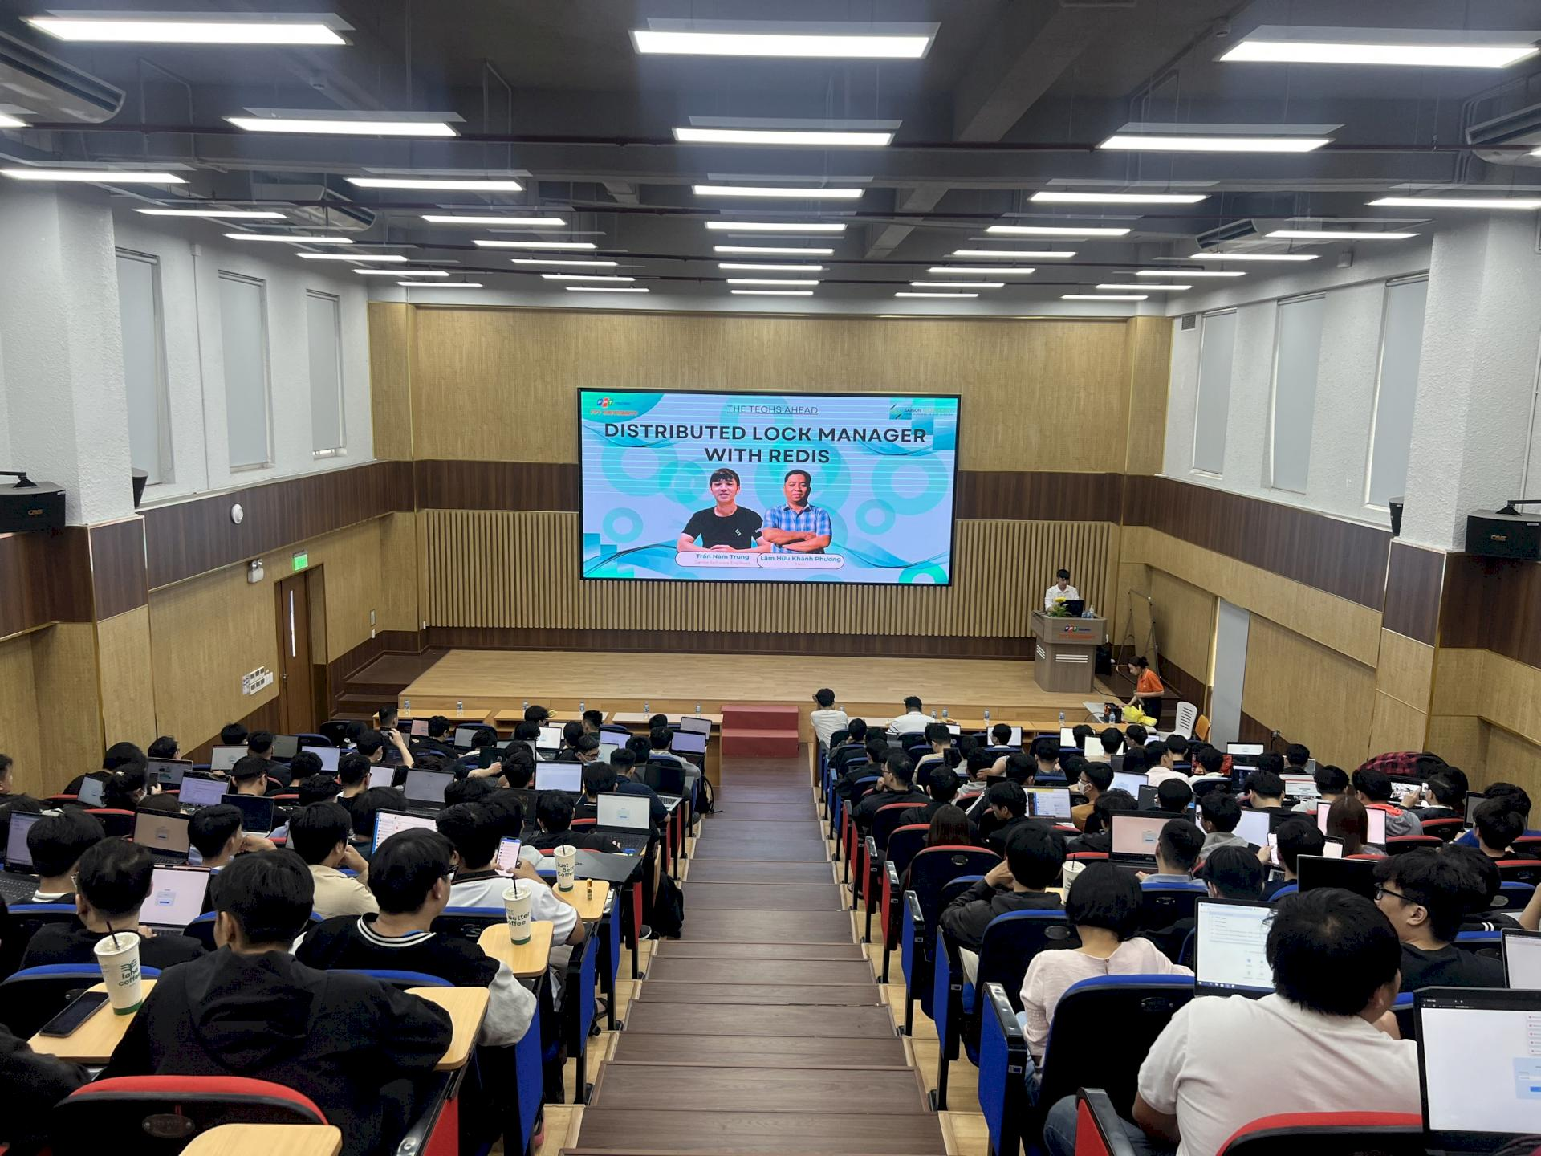
</ Saigon Technology
} /> [
/>

Slide 7
</ Contact
trannamtrung1st@gmail.com
(+84)76 544 1077 https://www.linkedin.com/in/trung-tran99/
} /> [
/>

Slide 8
01
Context & problems
</>
} /> [

Slide 9
1. Context and problems
</ Relational database & transactions
Transaction is a single unit of logic or work
ACID properties:
Atomic
Consistent
Isolated
Durable
/>

Slide 10
1. Context and problems
</ Transaction in a distributed system
Atomicity: a single unit with set of operations that must all occur or none occur
Consistency: data should only move from one state to another expected valid state in all participants
Isolation: ensures that concurrent transactions result in the same outcome when running sequentially
Durability: makes the commit status of transactions persistent and be able to bear with failure related to system or power outage

Slide 11
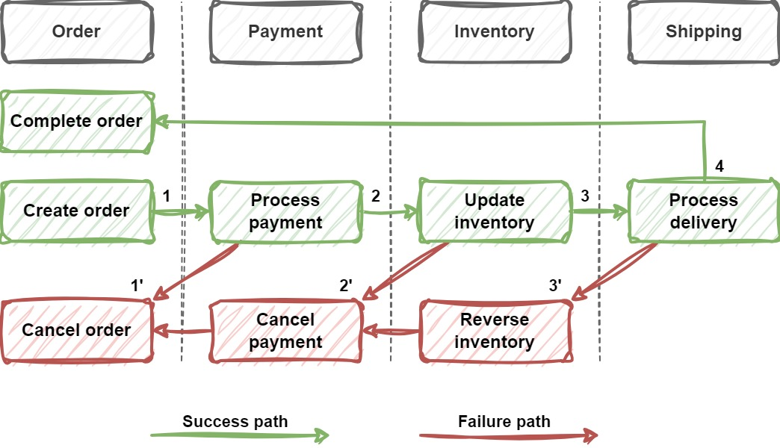
1. Context and problems
</ Sample order processing system
/>

Slide 12
1. Context and problems
</ Problems with a distributed transaction
Problems with transaction in a distributed environment
Due to usage of database-per-microservice, NoSQL databases, message brokers, file storage
-> They do not support Two-phase commit (2PC) protocol
/>

Slide 13
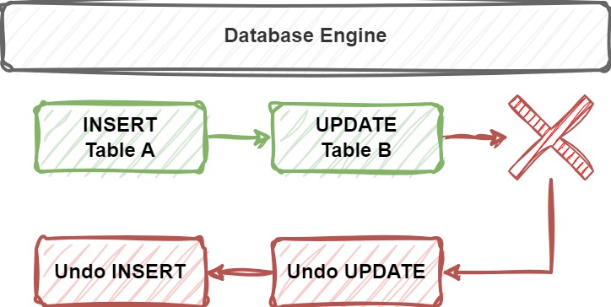
1. Context and problems
</ Problems with a distributed transaction
Problems with transaction in a distributed environment
Complicated rollback operations
/>

Slide 14
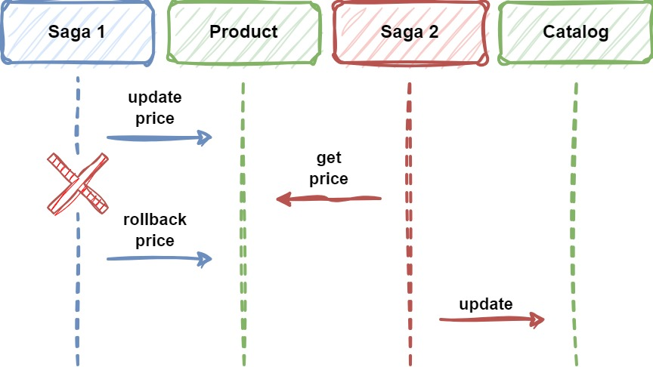
1. Context and problems
</ Problems with a distributed transaction
Problems with transaction in a distributed environment
Atomicity, consistency and isolation is a challenge
/>

Slide 15
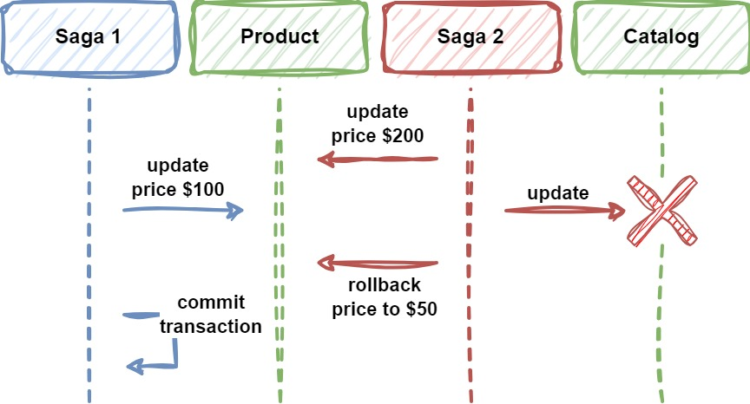
1. Context and problems
</ Problems with a distributed transaction
Problems with transaction in a distributed environment
Limitations with synchronicity and availability
/>

Slide 16
02
Saga - The solution
</>
} /> [

Slide 17
2. Saga - The solution
</ What is Saga pattern?
A transaction management strategy involving with multiple local transactions
A local transaction is performed by a saga participant
Each local transaction performs its transaction, then publishes events to trigger the next transaction
If local transaction fails, the saga will execute a series of compensating transactions that reverse/compensate the changes made before
/>

Slide 18
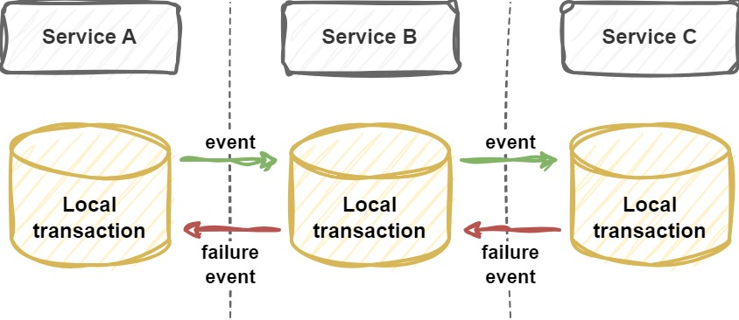
2. Saga - The solution
</ What is Saga pattern?
/>

Slide 19
2. Saga - The solution
</ Saga pattern - Concepts
Saga participants
Compensable & compensating transactions
Pivot transaction
Retryable transactions
Transaction key
/>

Slide 20
2. Saga - The solution
</ Saga participants
Services/software components that are responsible for one or more local transactions in the whole saga transaction
/>

Slide 21
2. Saga - The solution
</ Compensable, compensating transactions
Compensable transactions can potentially be undo by executing another transaction with the opposite effect
Compensating transactions reverse/compensate the changes made before by the compensable transactions
/>

Slide 22
2. Saga - The solution
</ Pivot transaction
The go/no-go (all or nothing) point in a saga
If the pivot transaction commits, the saga runs the remaining transactions until done
We can tell the saga is successful if a pivot transaction commits
A pivot transaction can be neither compensable nor retryable, or it can be the last compensable transaction or the first retryable transaction in the saga
/>

Slide 23
2. Saga - The solution
</ Retryable transactions
Follow pivot transaction and are guaranteed to succeed
For example, in ordering application
Create order
-> Compensating transaction will be Cancel order
Process payment
Update inventory
Delivery to customer → pivot transaction
Complete order → is retryable since all important steps are already successful

Slide 24
2. Saga - The solution
</ Transaction key
Each transaction should have a unique and consistent key across services
Is used to retrieve the transaction’s information
Marks entities or operations as associated with a specific transaction
Can be randomly generated and linked or must be able to construct using consistent hashing
/>

Slide 25
2. Saga - The solution
</ Implementation approaches
There are two common implementations:
Choreography
Orchestration
Each has its own set of challenges and techniques to manage the workflow
/>

Slide 26
03
Techniques in Saga
</>
} /> [

Slide 27
3. Techniques in Saga
</ Common techniques & design patterns
Asynchronous communication & Message broker
Asynchronous request-reply
"Replay" technique
Other techniques to ensure resiliency and target isolation, consistency issues
/>

Slide 28
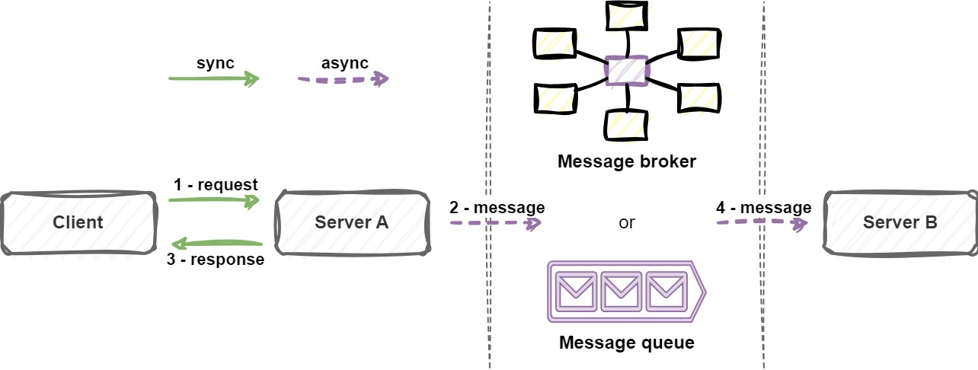
3. Techniques in Saga
</ Asynchronous communication & Message broker
/>

Slide 29
3. Techniques in Saga
</ Synchronous vs Asynchronous communication
Asynchronous fits Saga better
 | Synchronous | Asynchronous
Technique | HTTP request | Message queue/broker
Response time | Client waits for response | Quick response
Retry | Client waits for retry | Retry in background
Throughput | Lower | Higher
Timeout | Has timeout | Almost no timeout

Slide 30
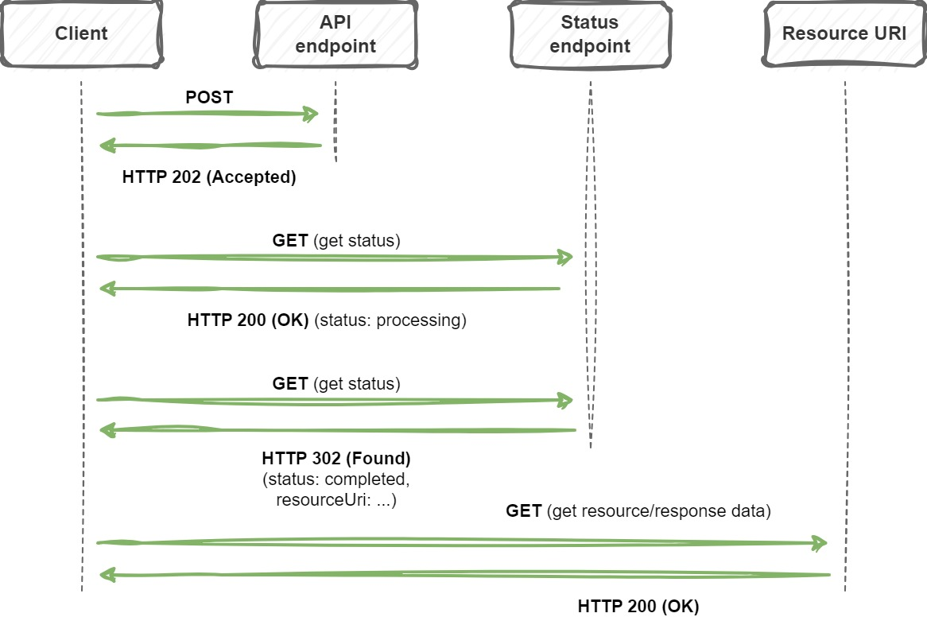
3. Techniques in Saga
</ Asynchronous request-reply
/>

Slide 31
3. Techniques in Saga
</ "Replay" technique
A group of logical operations can be replayed multiple times
Each operation is coordinated by the orchestrator
Operation status and result will be persisted
In the next replay, persisted result will be used if available
-> Is usually used with Event-sourcing architecture
-> More clear and readable but complicated
/>

Slide 32
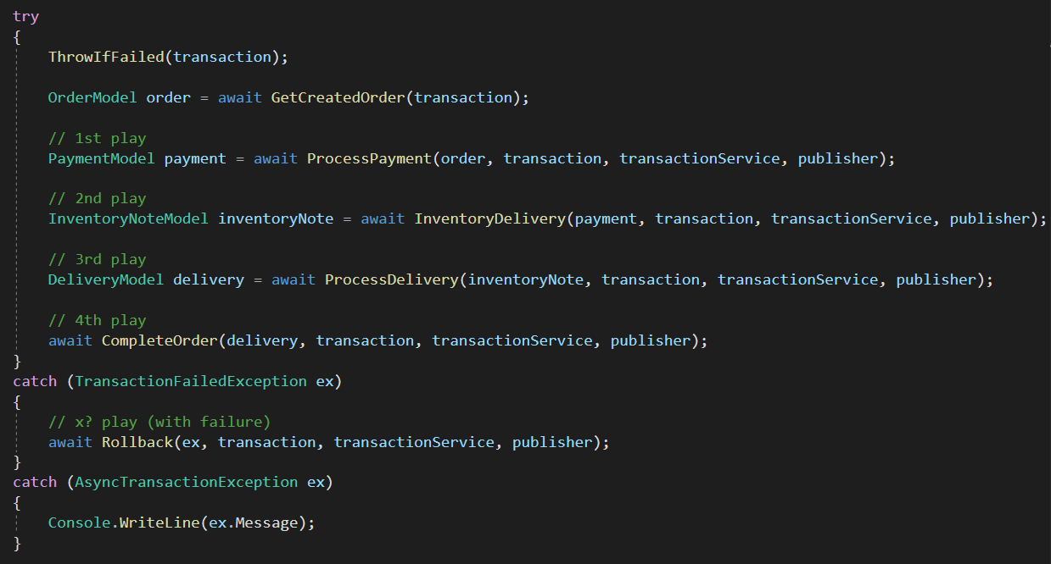
3. Techniques in Saga
</ "Replay" technique

Slide 33
3. Techniques in Saga
</ Other techniques
To ensure resiliency and target isolation, consistency issues
Heartbeat pattern
Retry
Semantic lock
Optimistic locking
Different concurrent read techniques
/>
Notes:
Semantic lock: khóa resource với một ý nghĩa nhất định, ví dụ đang thực hiện việc gì đó

Slide 34
04
Saga - Choreography
</>
} /> [

Slide 35
4. Saga - Choreography
</ What is choreography-based saga?
A way to coordinate sagas where events are exchanged using a message broker or any mechanism without a centralized controller
Each local transaction publishes events that trigger local transactions in other participants
Participants must know each other’s events to be able to handle them
/>

Slide 36
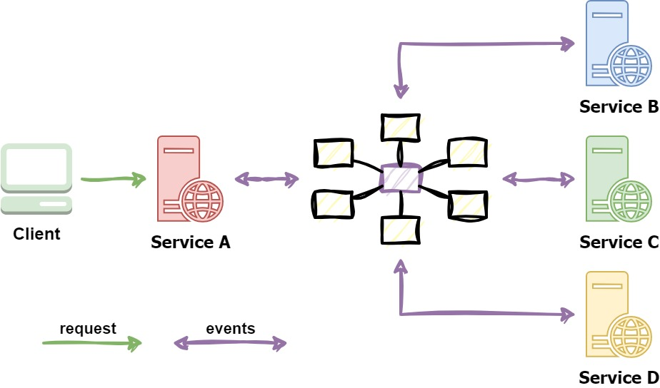
4. Saga - Choreography
</ What is choreography-based saga?
/>

Slide 37
4. Saga - Choreography
</ Apply to our problem (Success path)
Create order -> ?
/>

Slide 38
4. Saga - Choreography
</ Apply to our problem (Success path)
Create order -> Order created ->
Process payment -> Payment created ->
Inventory delivery -> Delivery note created ->
Process delivery -> Delivery created ->
Complete order -> Order completed
/>

Slide 39
4. Saga - Choreography
</ Apply to our problem (Failure paths)
Create order -> Create order failed
... Process payment -> Payment failed ->
Cancel order
... Inventory delivery -> Inventory delivery failed ->
Cancel order, Cancel payment
... Process delivery -> Delivery failed ->
Cancel order, Cancel payment, Reverse inventory delivery

Slide 40
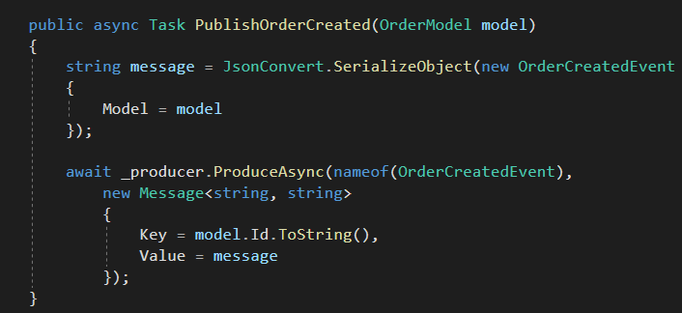
4. Saga - Choreography
</ Apply to our demo (Publishing events)
/>
OrderService

Slide 41
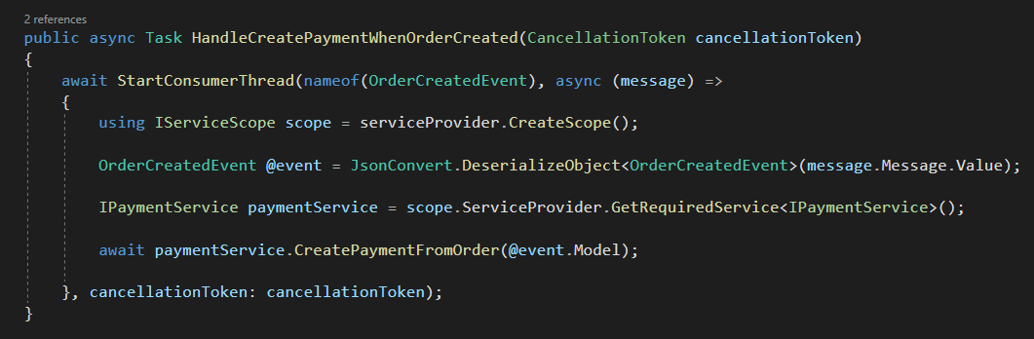
4. Saga - Choreography
</ Apply to our demo (Handling events)
PaymentService
/>

Slide 42
4. Saga - Choreography
</ Choreography - Pros & Cons
Pros
Good for simple, few participants, no need coordination logic workflows
No need to maintain orchestrator service
No single point of failure
Responsibilities are shared and distributed
Cons
Cumbersome when adding new participants and steps
Complicated dependencies (cyclic, tight coupling) between participants
All services must be running to simulate a transaction -> difficult to do integration testing

Slide 43
05
Saga - Orchestrator
</>
} /> [

Slide 44
5. Saga - Orchestrator
</ What is orchestrator-based saga?
Orchestrator coordinates sagas using a centralized controller
Trigger participants local transactions to perform in case of events
Handle failures by running compensating transactions/actions
Status can be managed and persisted for monitoring and management purposes
/>

Slide 45
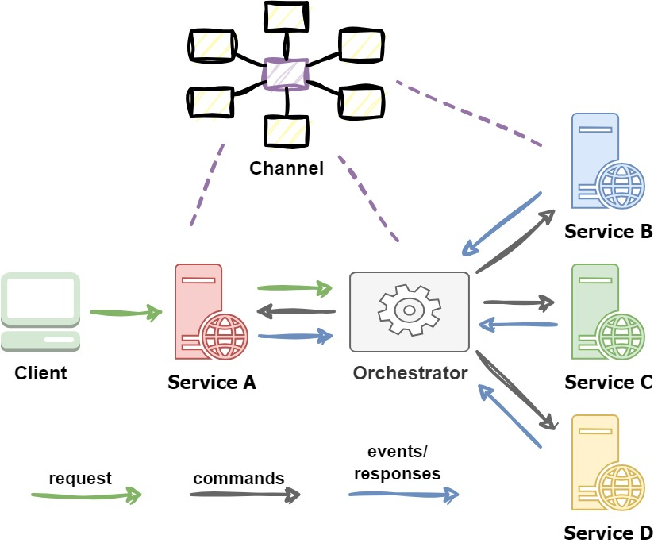
5. Saga - Orchestrator
</ What is orchestrator-based saga?
/>

Slide 46
5. Saga - Orchestrator
</ Apply to our problem (Success path)
Create order -> Order created -> ?
/>
Notes:
NOTE: we can start Orchestrator to create the order (depend on implementation)

Slide 47
5. Saga - Orchestrator
</ Apply to our problem (Success path)
Create order -> Order created -> Orc ->
C:Process payment -> Payment created -> Orc ->
C:Inventory delivery -> Delivery note created -> Orc ->
C:Process delivery -> Delivery created -> Orc ->
C:Complete order -> Order completed -> Orc
Annotation
Orc: Orchestrator C:{action}: command that triggers action
Notes:
NOTE: we can start Orchestrator to create the order (depend on implementation)

Slide 48
5. Saga - Orchestrator
</ Apply to our problem (Failure paths)
... Process payment -> Payment failed -> Orc ->
C:Cancel order
... Inventory delivery -> Inventory ... failed -> Orc ->
C:Cancel order, C:Cancel payment
...
Annotation
Orc: Orchestrator C:{action}: command that triggers action
Notes:
NOTE: we can start Orchestrator to create the order (depend on implementation)

Slide 49
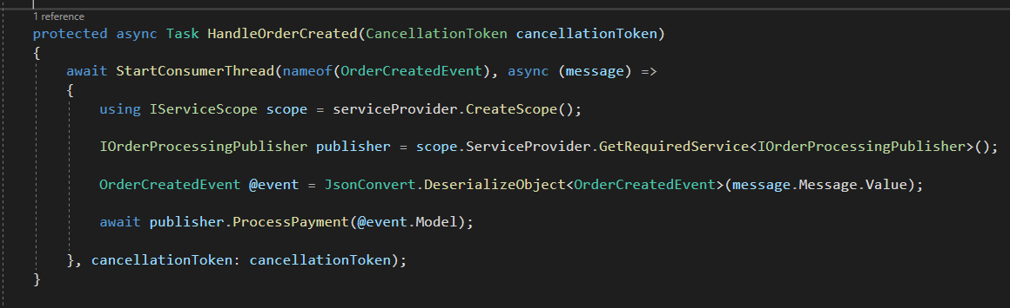
5. Saga - Orchestrator
</ Apply to our demo (Orchestrator handles events)
/>
Orchestrator

Slide 50
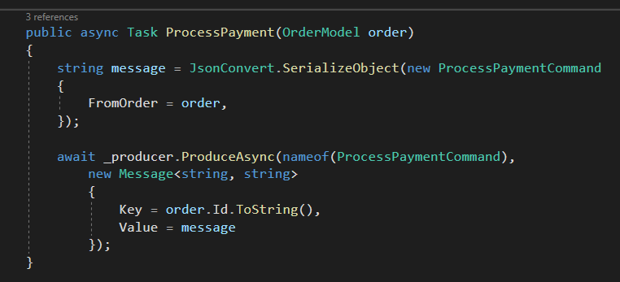
5. Saga - Orchestrator
</ Apply to our demo (Orchestrator publishes commands)
/>
Orchestrator

Slide 51
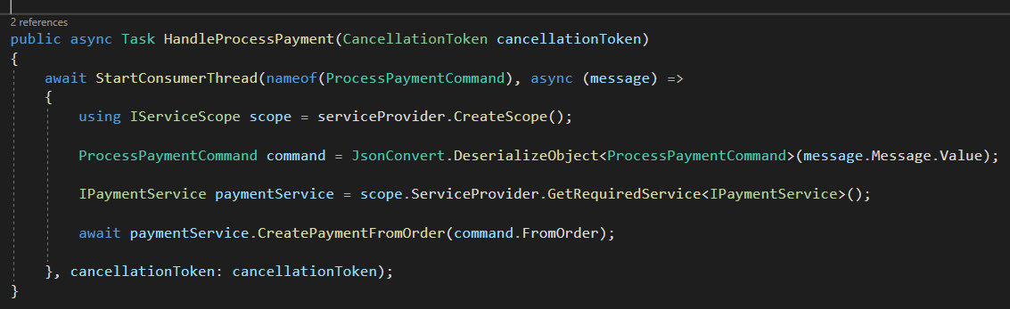
5. Saga - Orchestrator
</ Apply to our demo (Services handle commands)
/>
PaymentService

Slide 52
5. Saga - Orchestrator
</ Orchestrator - Pros & Cons
Pros
Suitable for complex, many participants or new participants added over time workflows
Good when flow of tasks and activities are under control
No cyclic dependencies
Separation of concerns
Cons
Additional effort to maintain, implement coordination logic
Single point of failure
/>
Notes:
Orchestrator will know all participants but the participants themselves don’t need to know each other
Participants does not need to handle others’ events

Slide 53
06
Issues & considerations
</>
} /> [

Slide 54
6. Issues & considerations
</ Some considerations
Can be challenging in the beginning
Hard to debug
Complexity grows when there are more participants
Consistency is relative only, because changes are committed to local databases
Improper transient failures handling can cause side-effects
Difficult to manage without proper monitoring and observability implemented
Notes:
Idempotence means a logic can be repeated multiple times without changing the initial result

Slide 55
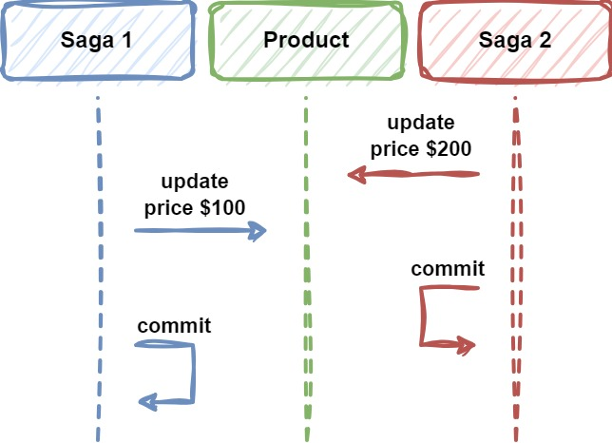
6. Issues & considerations
</ Common issues - Lost updates
Lost updates, a participant updates data without reading latest changes
/>

Slide 56
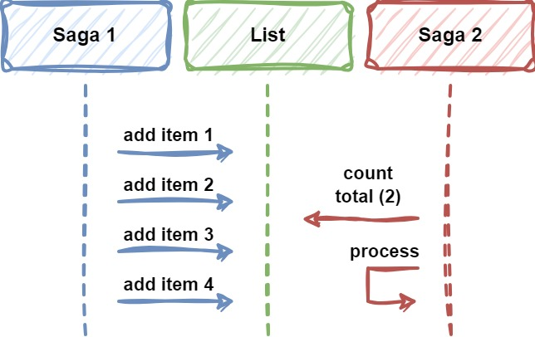
6. Issues & considerations
</ Common issues - Dirty reads
Dirty reads, when a participant reads data that is just partially updated by another saga
/>

Slide 57
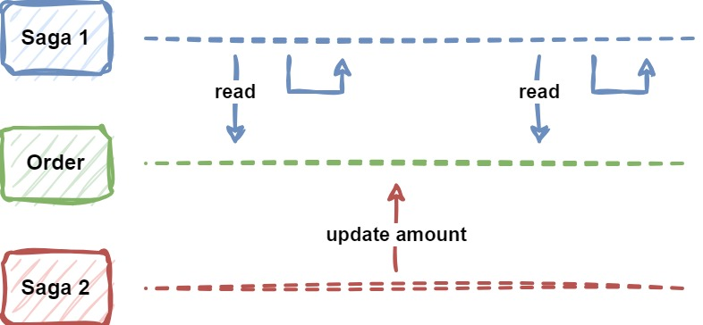
6. Issues & considerations
</ Common issues - Fuzzy/non-repeatable reads
Fuzzy/non-repeatable reads, data is not consistent across participants since data can be updated at some points throughout the entire saga workflow
/>

Slide 58
6. Issues & considerations
</ Countermeasures against isolation issues
Semantic lock
Commutative updates
Pessimistic view
Reread value and restart if data changed
Record operations in arriving order to execute sequentially
Low-risk requests use sagas, high-risk requests favor distributed transactions (2PC, 3PC distributed transaction commit/rollback protocol)
Notes:
Commutative updates: updates that can be made in any order without changing the expected result
Pessimistic view: reorders the saga, so data updates will be placed in a retryable transaction, which, at the same time, makes saga participants to read the original data and ensure data updates in the end. → calculate the whole order info throughout the saga, update at the end in a retryable transaction

Slide 59
6. Issues & considerations
</ Solutions for resiliency
Rate limiting
Delay & retry
Idempotency
/>

Slide 60
07
Practical usage
</>
} /> [

Slide 61
7. Practical usage
</ When to use
Ensure data consistency in a distributed system without tight coupling
Efficiently execute compensating actions if one of the operations fails in the distributed action sequence
/>

Slide 62
7. Practical usage
</ When to use
Microservices
Cloud-based applications
Saga pattern - AWS Prescriptive Guidance (amazon.com)
Saga pattern - Azure Design Patterns | Microsoft Learn
Saga pattern - IBM Cloud Architecture Center
/>

Slide 63
7. Practical usage
</ When to use
Banking applications: Patterns and implementations for a banking cloud transformation - Azure Architecture Center | Microsoft Learn
Media processing system: Gridwich saga orchestration - Azure Reference Architectures | Microsoft Learn
/>

Slide 64
7. Practical usage
</ When to NOT use
Monolithic architecture
Tightly coupled operations and transactions
Cyclic dependencies
/>

Slide 65
7. Practical usage
</ Summary
So far, we have learned that:
The use of Saga pattern in distributed transaction
Some common techniques used in Saga
Two Saga implementations: Choreography & Orchestrator
Some common issues and challenging when apply Saga
/>

Slide 66
08
Discussion
& QnA
</>
} /> [

Slide 67
</ References
Saga pattern - Azure Design Patterns | Microsoft Learn
Patterns and implementations for a banking cloud transformation - Azure Architecture Center | Microsoft Learn
Gridwich saga orchestration - Azure Reference Architectures | Microsoft Learn
Saga Pattern in Microservices | Baeldung on Computer Science
Saga Pattern for Microservices Distributed Transactions | by Mehmet Ozkaya | Design Microservices Architecture with Patterns & Principles | Medium
Distributed transaction - SAGA pattern (viblo.asia)
Implement a distributed transaction in microservices software system using Saga pattern | Careers Saigon Technology
/>

Slide 68
Thanks!
</
} /> [
Do you have any questions?
trannamtrung1st@gmail.com
(+84)76 544 1077 https://www.linkedin.com/in/trung-tran99/
/>
Please keep this slide for attribution

